Slide 1
Part of Speech Tagger - English
Presented by
MADURU SADAK PRAMODH
1115608
Guided by
Dr. M.HUMERA KHANAM
Professor and HOD, CSE

Slide 2
Introduction
Introduction
Abstract
Problem statement
Problem solution
Implementation and design
Results
Conclusion
References

Slide 3
Introduction
The first step in implementing a part-of-speech tagger is to build a lexicon.
• Rule-based tagging and Stochastic tagging.
• The goal is to assign classifications to a set of samples. • There are two components of a transformation: a rewrite rule and a triggering environment.
• Brill’s Learning Algorithm is used in POS tagger.

Slide 4
Abstract
A part of speech labelling is the measurable depiction which is the procedure of partitioning each word with its grammatical feature kind. The achievement for Swedish strategy is portrayed by this paper in light of Brill Method. Here we are related with the client entered words with their related part of speech which are open in the corpus and furthermore we discover the part of speech of non-exist words by an event of words in an application which are entered by the client.
Our technique is reasonable when the tag of a word is known for certain and is introduced with help and enhance the precision of order by giving a solid secure begin around which to tag.

Slide 5
Problem statement
POS tagging also called as grammatical tagging or word-category disambiguation, is the process of marking up a word in a text (corpus) as corresponding to a particular part of speech, based on both its definition and its context i.e., its relationship with adjacent and related words in a phrase, sentence or a paragraph.

Slide 6
Problem solution
The execution of grammatical form tagger is begun by building a dictionary, wherever the grammatical feature of a word can be found. Tragically many words are questionable and each word will have numerous classiﬁcations. For instance, the word note will be either a thing or a verb. It is the object of the grammatical form tagger to determine these ambiguities, by misusing the setting of the word
For that we proposed a pre set of rules and with help of Microsoft cognize services built a robust and unique solution for a problem

Slide 7
Implementation and design
Learner
Contextual RuleLearner
Unknown word RuleLearner
Rule
CorpusReader
Tagger
Tokenizer
Word Dictionary
Tag Dictionary

Slide 8
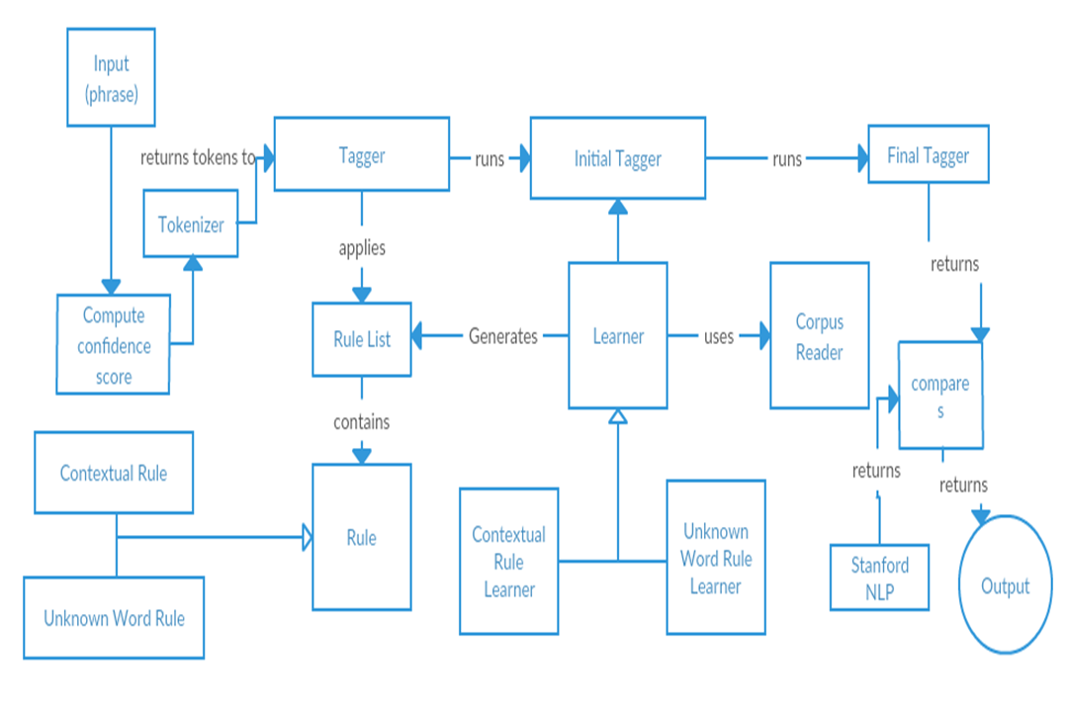
Block diagram

Slide 9
Pseudo code for Brill’s learning algorithm
While (nbr of errors> threshold)
for (each error)
for (each rule r correcting the error)
good(r) = nbr of good transformations
bad(r) = nbr of bad transformations
score(r) = good(r) - bad(r)
Apply the rule with highest score and append it to the rule list
*nbr = number

Slide 10
The contextual transformation template
The preceding/following word is tagged with Z. (PREVTAG/NEXTTAG)
2. One of the two preceding/following words is tagged with Z. (PREV1OR2TAG/NEXT1OR2TAG)
3. One of the three preceding/following words is tagged with Z. (PREV1OR2OR3TAG/NEXT1OR2OR3TAG)
4. The preceding word is tagged with Z and the following word is tagged with V. (SURROUNDTAG)
5. The preceding/following two words are tagged with Z and V. (PREVBIGRAM/NEXTBIGRAM)
6. The word two words before/after is tagged with Z. (PREV2TAG/NEXT2TAG)
7. The current word is Z. (CURWD)

Slide 11
Continue
8. The preceding/following word is W. (PREVWD/NEXTWD)
9. One of the preceding/following words is W. (PREV1OR2WD/NEXT1OR2WD)
10. The word two words before/after is W. (PREV2WD/NEXT2WD)
11. The current word is Z and the preceding word is V. (LBIGRAM)
12. The current word is V and the following word is Z. (RBIGRAM)
13. The current word is V and the preceding/following word is tagged with Z. (WDPREVTAG/WDNEXTTAG)
14. The current word is V and the word two words before/after is tagged with Z. (WDAND2BFR/WDAND2TAGAFT)

Slide 12
Results
precision (P): Precision is the fraction of the correct tags generated by the POS to the total number of tags generated.
Precision (P) =Correct answers/answers produced
Recall(R): Recall is the fraction of the correct tags generated by the POS to the total number of correct tags.
Recall (R) = correct answers/ total possible correct answers.
F-Score: F-score is the weighted harmonic mean of precision and recall.
F-Measure = (ß2 ß2R+P).
ß is the weighting between precision and recall and typically ß=l.
F-Measure = (ß + 1) PR/ (ß R + P)
According to our observations, without window size, organizations identification gives very less performance. In this study we have taken tokens only, that is, the sentences are split into tokens using space and some predefined words. With this model we have achieved f-score of 95.18%.

Slide 13
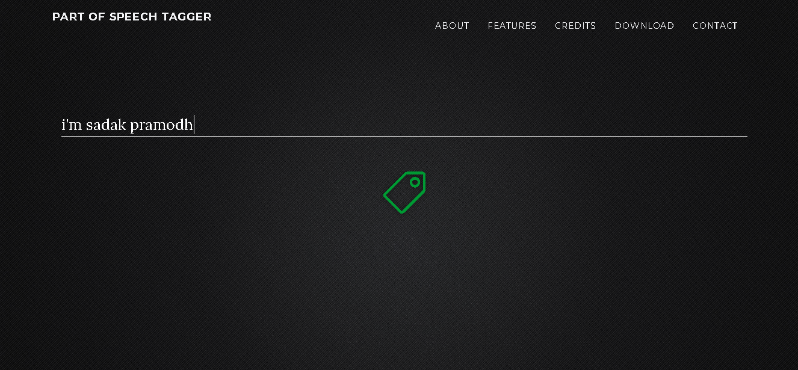
Continue

Slide 14
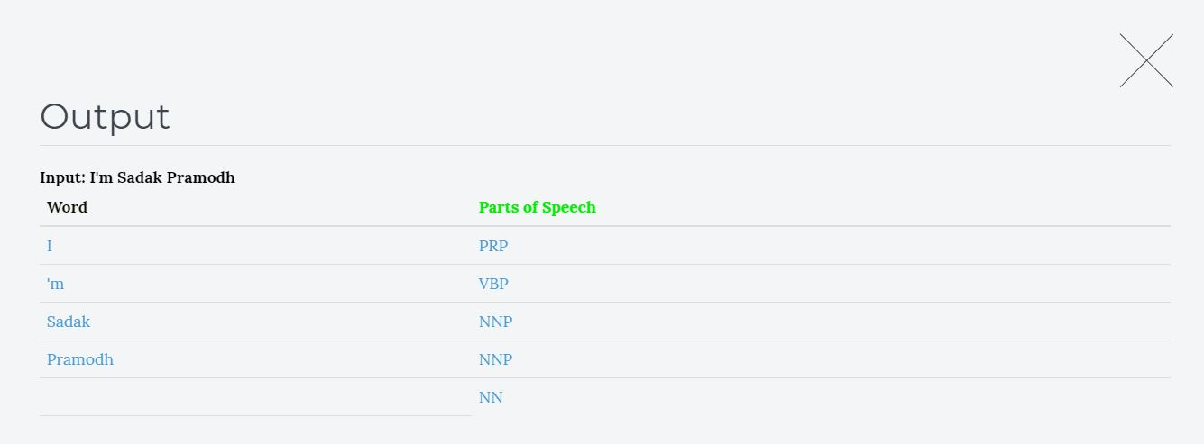
Output Screen

Slide 15
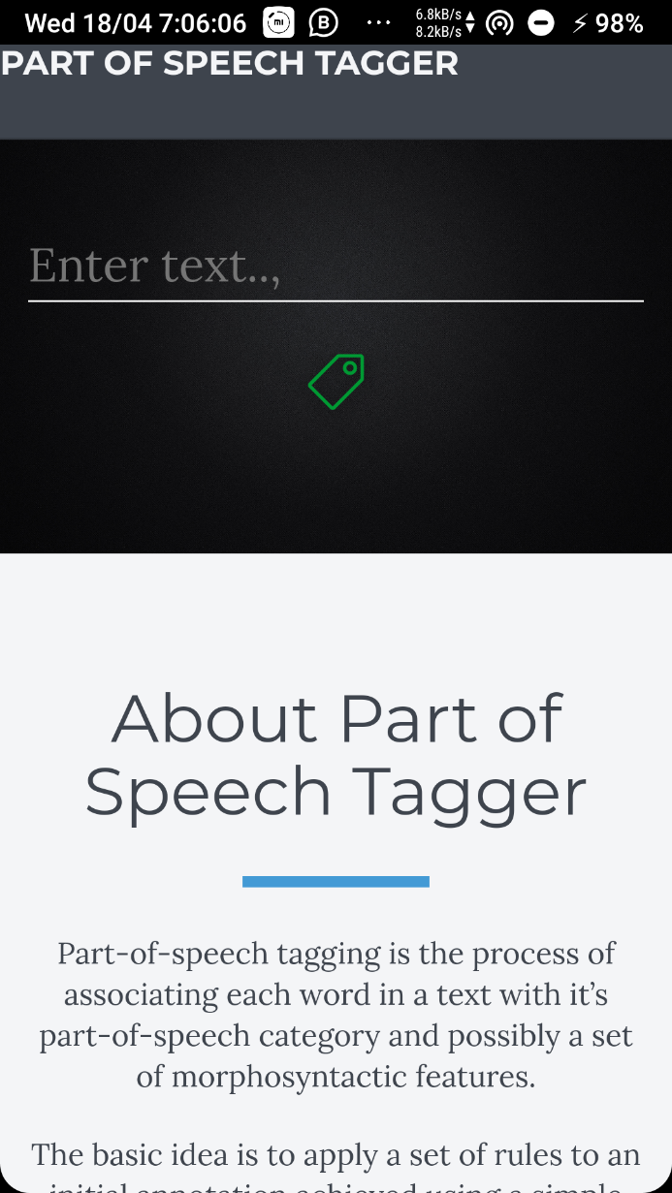
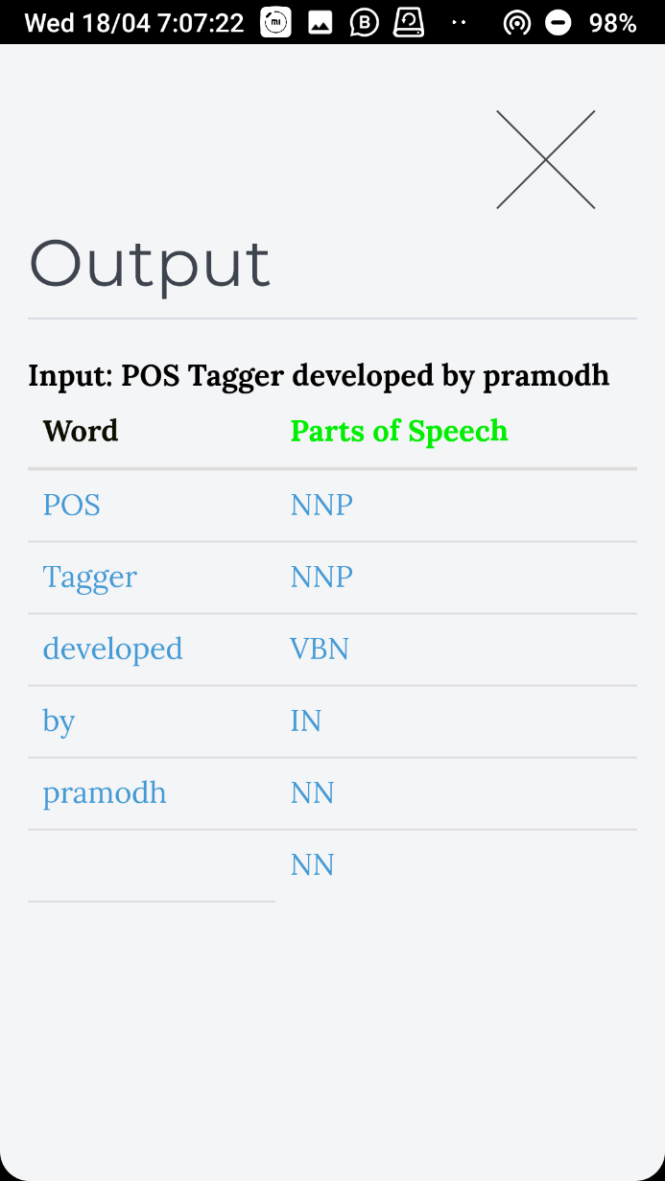
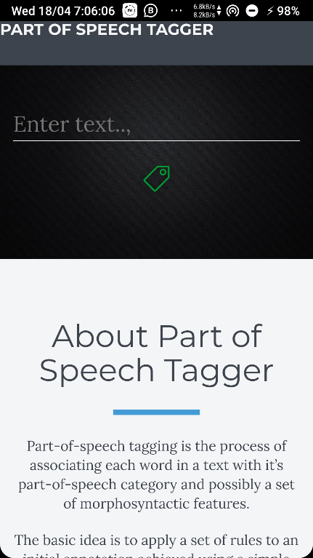
Mobile App

Slide 16
Conclusion
We have proposed handling of Unknown Words Unfortunately, most of the rules for unknown words turned out to give poor results. The optimization of the original tagger was very successful, resulting in a running time almost 15 times faster when using a training corpus of 23000 words.
The final result of our work can be summarized in the figures showing the accuracy of the tagger. The resulting accuracy was computed to 95.18 % and 92.94 %, with a closed and open vocabulary respectively.
This application is deployed in Microsoft Azure Cloud and achieved client server model for business and research purposes.

Slide 17
References
Transformation-Based Learning by Christian Siefkes.
Brill Tagging on the Micron Automata Processor by Keira Zhou; Jeffrey J. Fox; Ke Wang; Donald E. Brown.
Part-of-Speech Tagging Using the Brill Method Maria Larsson and M˚ans Norelius. • B. Revathi, Dr. M. Humera Khanam “Hindi To English Part Of Speech Tagger By Using CRF Method”.
Eric Brill. 1995. Transformation-Based ErrorDriven Learning and Natural Language Processing: A Case Study in Part-of-Speech Tagging.

Slide 18
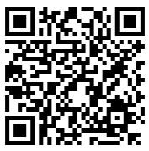
Thank You
Scan QR code to get project

